Slide 1

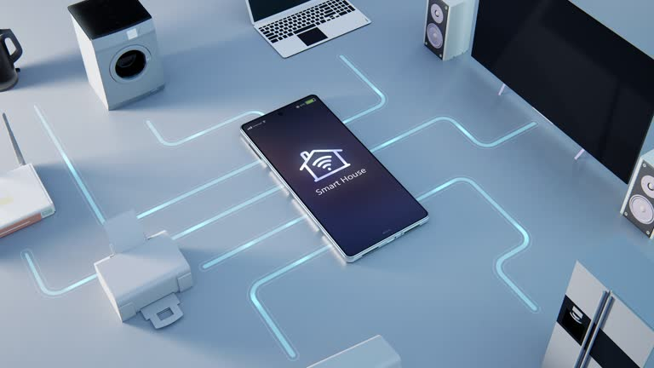
Network Devices
Aashish Subedi
aashishsubedi478@gmail.com

Slide 2
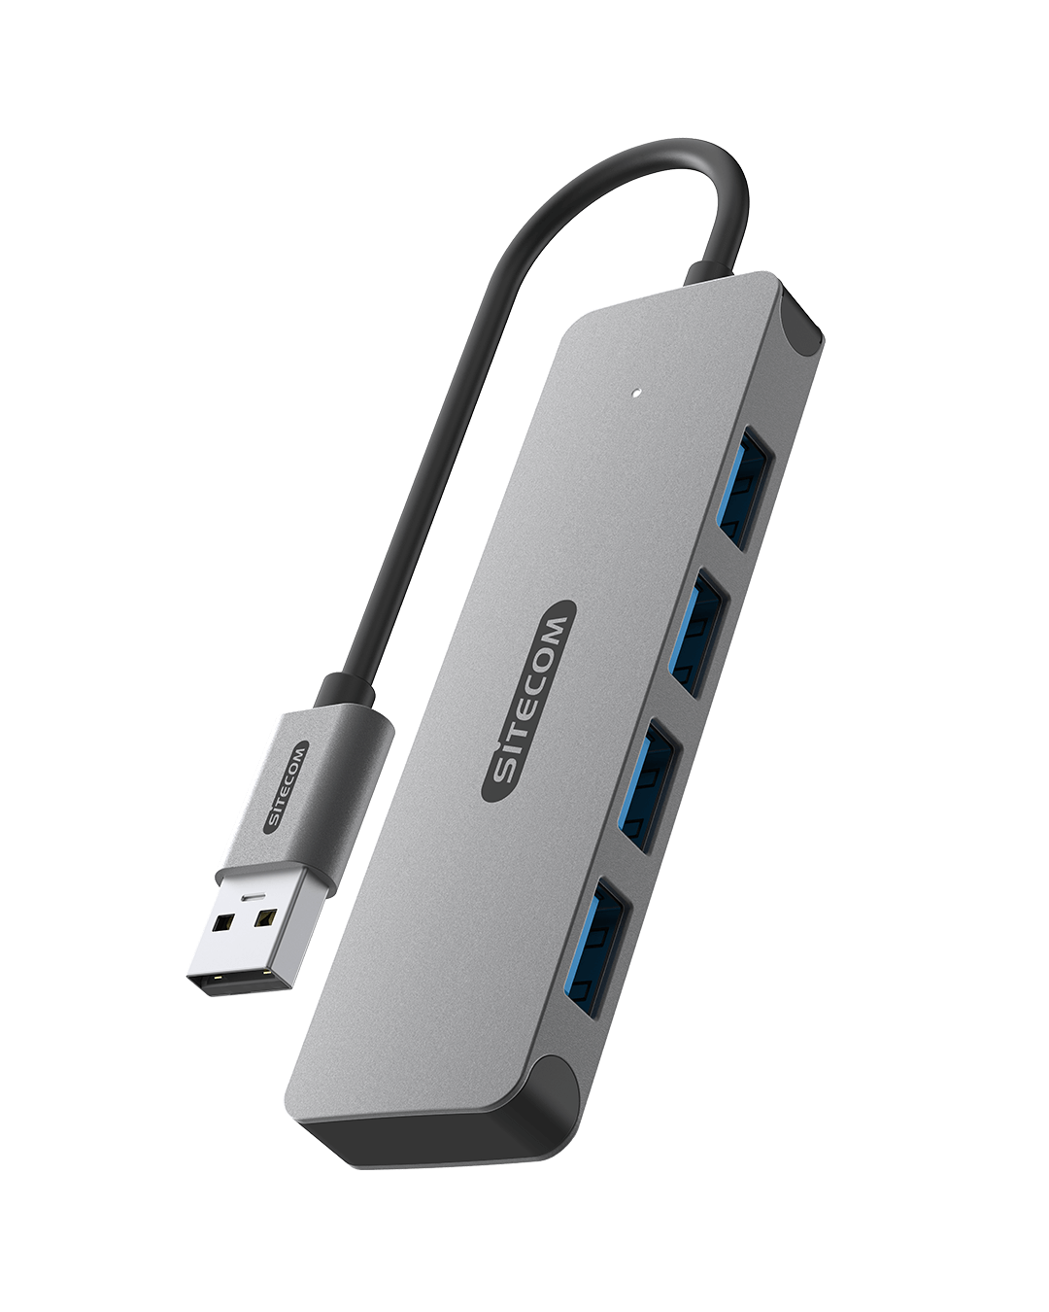
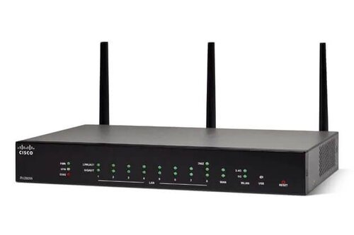
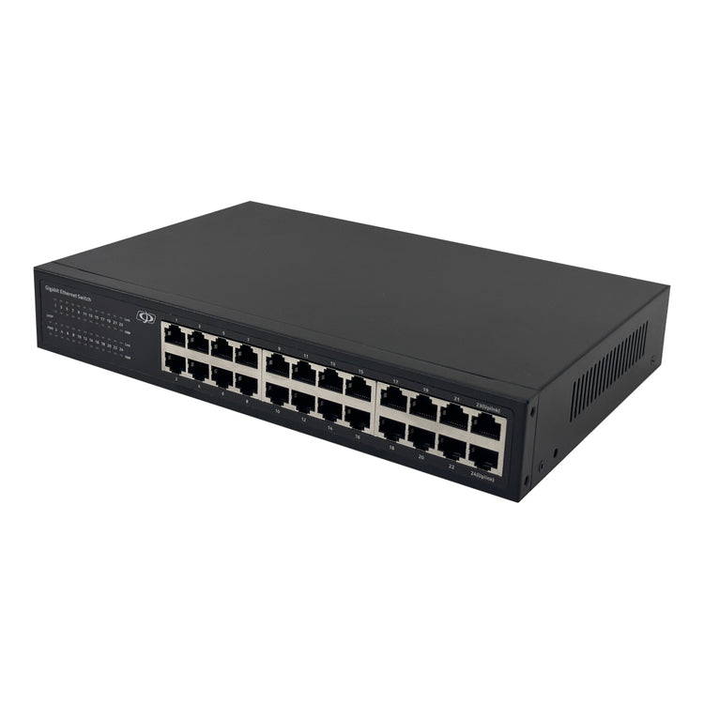
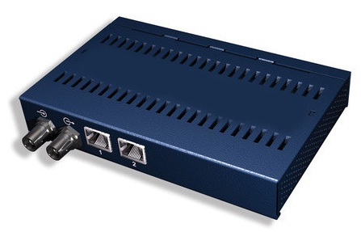
Network devices
HUB
Switch
Router
HUB
ROUTER
Bridge
Repeater
Curiosity
SWITCH
REPEATER

Slide 3
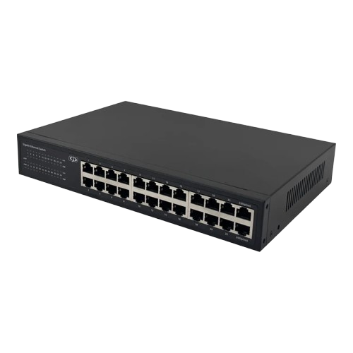
Switch
A switch connects devices in a LAN and sends data to the correct device using MAC addresses.
It works at Layer 2 and reduces network traffic for faster communication.
Fig: Network Device Switch

Slide 4
Hub
A hub connects multiple devices in a network but broadcasts data to all ports, not just the intended one.
It works at Layer 1 (Physical Layer) and is less efficient than a switch.
Fig: Network Device Hub

Slide 5
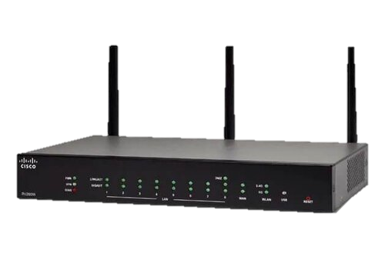
Router
A router connects multiple networks and sends data based on IP addresses.
It works at Layer 3 (Network Layer) and directs the best path for data to travel.
Fig: Network Device Router

Slide 6
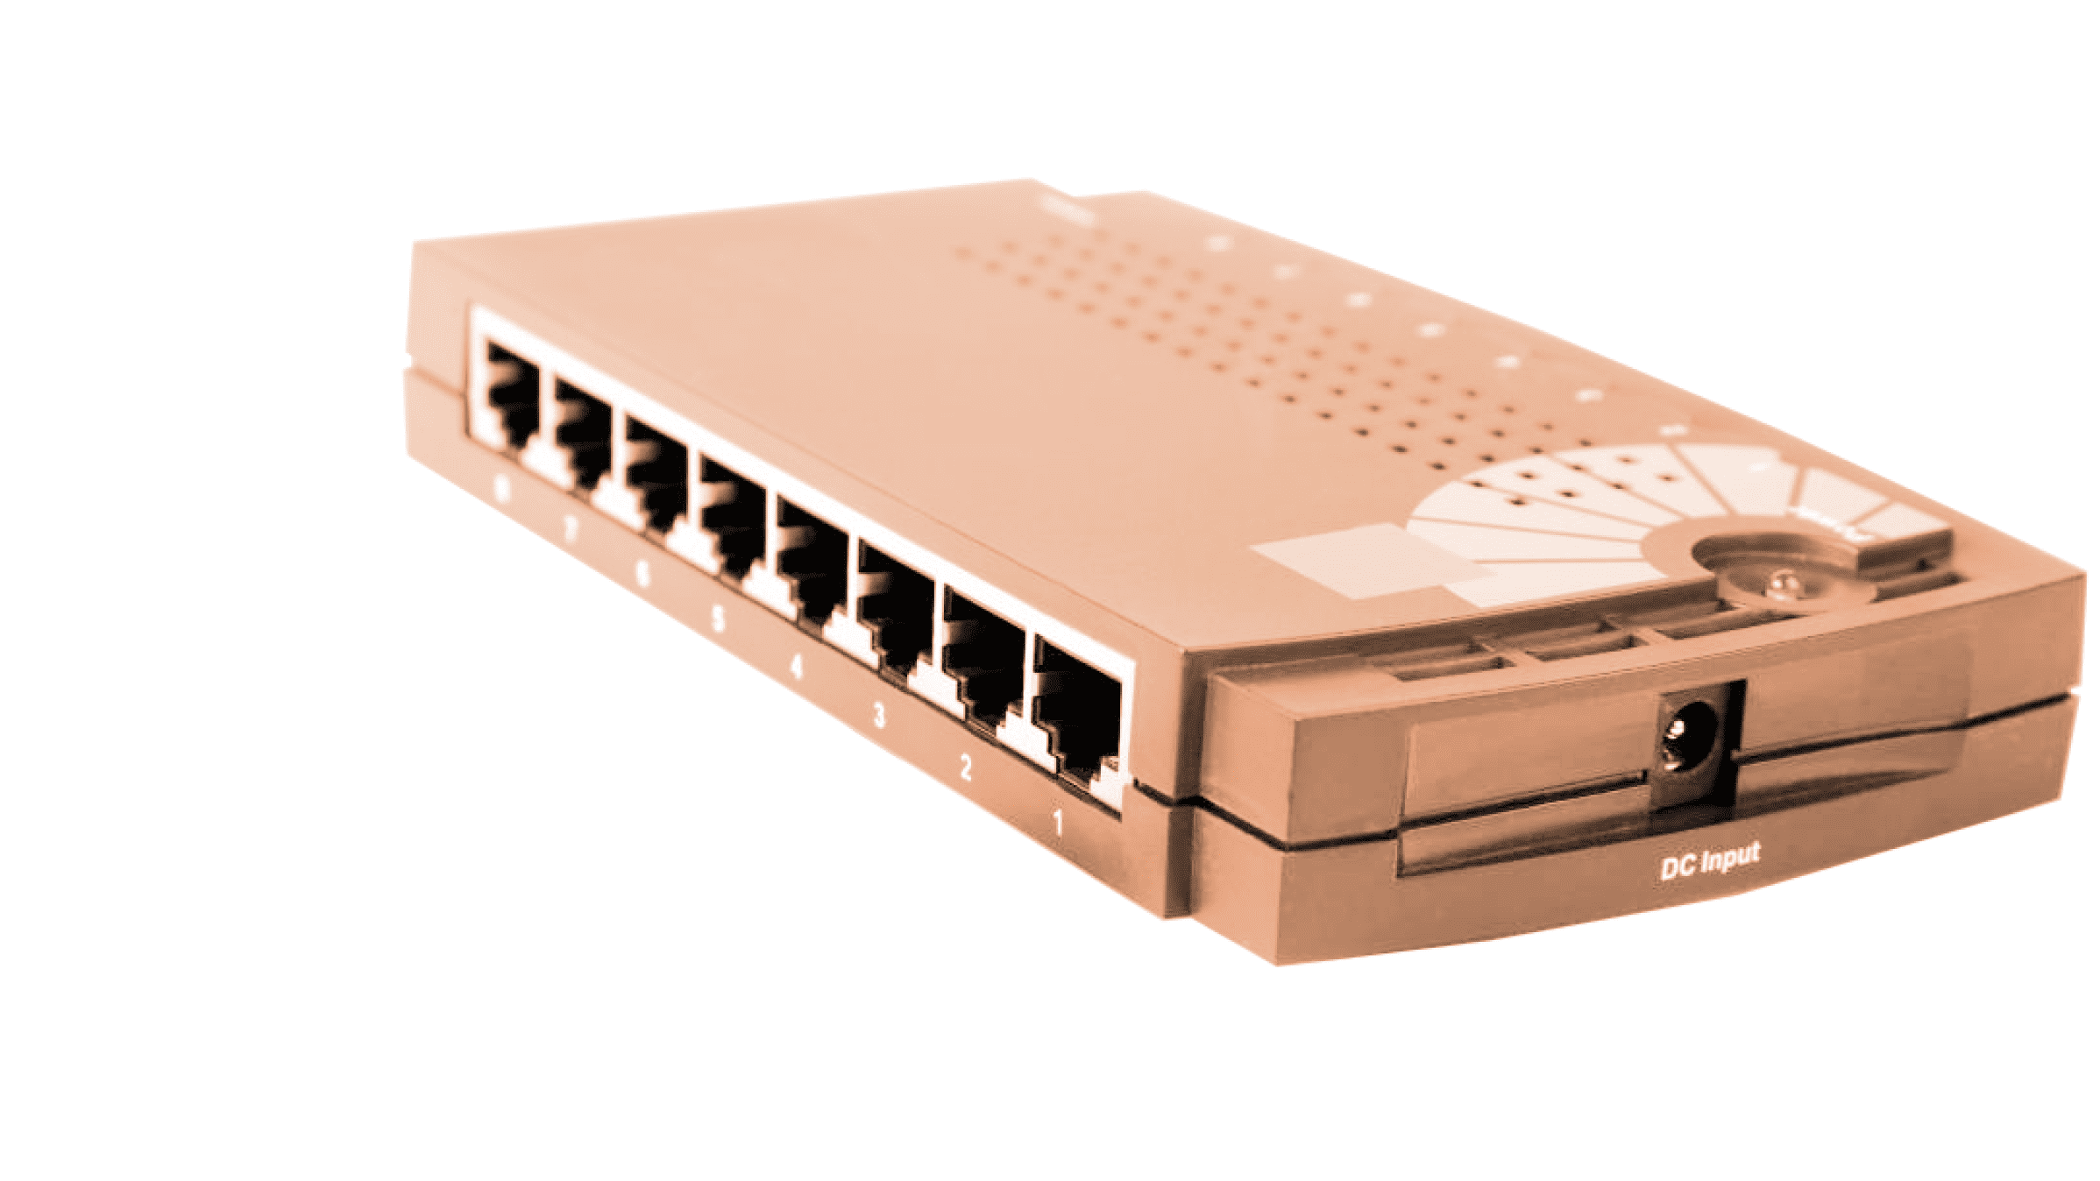
Bridge
A bridge connects and filters traffic between two network segments.
It works at Layer 2 (Data Link Layer) and reduces unnecessary traffic by using MAC addresses.
Fig: Network Device Bridge

Slide 7

Thank You
Aashish Subedi
aashishsubedi478@gmail.com

